Slide 1

Marking the World More Accessible, One Place at a Time
A Presentation by RightHear to the
AER Virginia Conference
26th March 2026
2026 All Rights Reserved
Confidential

Slide 2
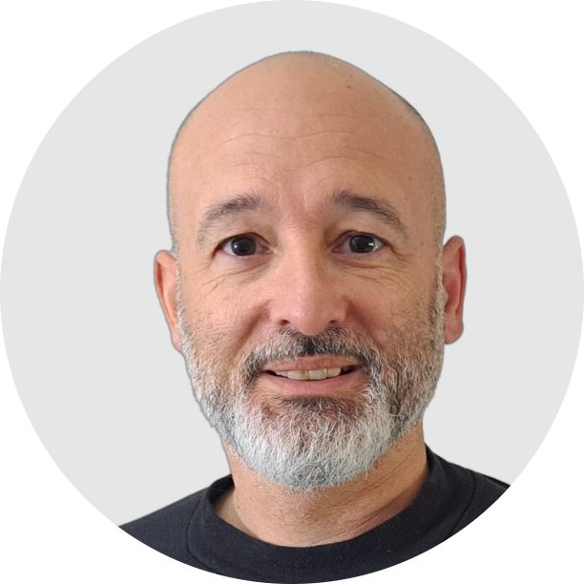
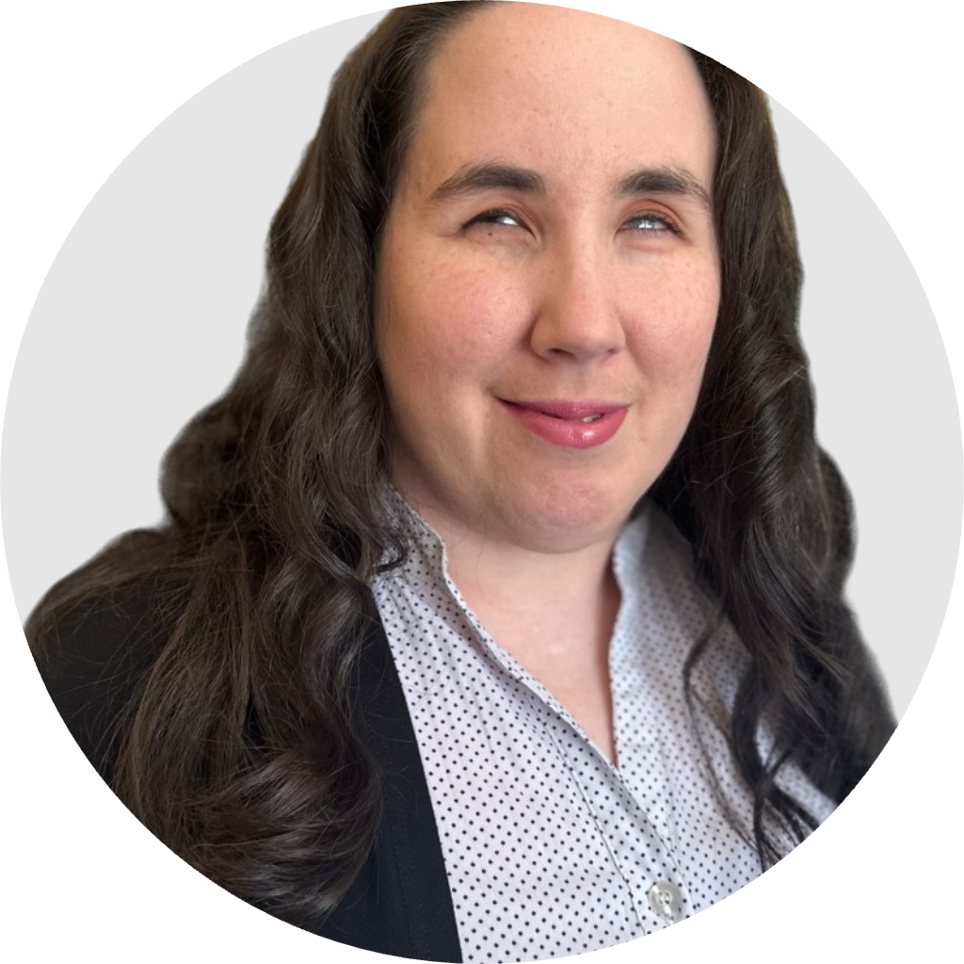
Today’s Speakers
Darren Gladstone
US Operations Director
RightHear
Shanell Matos
Community Manager
RightHear
2026 All Rights Reserved
Confidential

Slide 3
Why Accessibility Matters?
Introduction to RightHear
How the Product Works
Join the Movement
Q&A
Session Agenda
Session Goal:
Introduce a new approach to Accessible Signage, Wayfinding and Spatial Orientation.
2026 All Rights Reserved
Confidential

Slide 4


90% +
98% +
92% +
Of people who are blind don’t know braille
Of people who are blind don’t use guide dogs
Of people with visual impairments don’t use a white cane
Confidential
2025 All Rights Reserved
Notes:
Shanell Talking

Slide 5
Why Accessibility Matters?
Equal Access to Spaces
  Accessibility ensures people with disabilities can fully enjoy and experience all spaces
Large and Growing Need
        Growing numbers of people with accessibility needs
Legal Compliance
  Organizations must comply with laws like the Americans with Disabilities Act (ADA)
Better Experiences for Everyone
  Accessible design benefits us all, whether we need it now, or in the future
2026 All Rights Reserved
Confidential
Notes:
Shanell Matos, in her own words…
Independence: Dignity, or not having anyone to go with
Reducing anxiety in a busy, stressful situations
Often have to move between various locations within a Stadium
Sport brings people together, and that is the ultimate in accessibility.
Be part of the Community of fans

Slide 6
Last Yards Accessibility
GPS solutions can help people find their way around public spaces, but we need solutions that help people indoors, and in outdoor spaces such as parks, sports stadiums, campuses and more.
Last Yards accessibility is vital in delivering effective accessibility, and real independence.
2026 All Rights Reserved
Confidential
Notes:
Shanell Talking

Slide 7
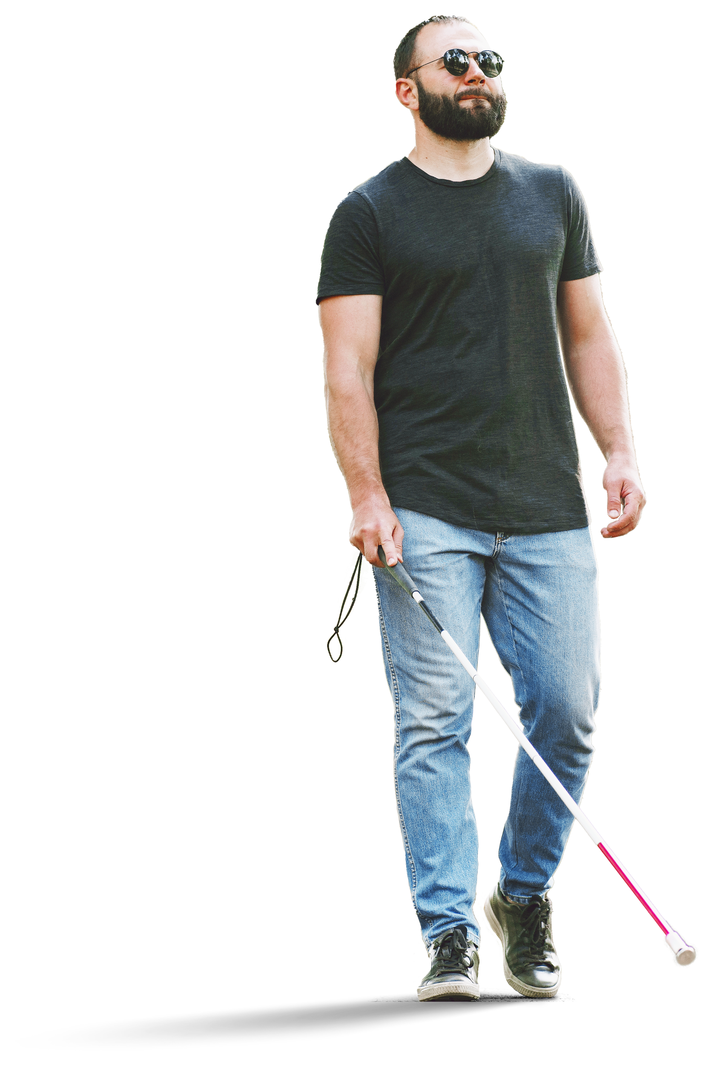
Making the world, and Virginia, more accessible, one space at a time.
Our Mission with you today is to start the journey towards making Virginia more accessible for everyone.
Our Mission
2026 All Rights Reserved
Confidential

Slide 8
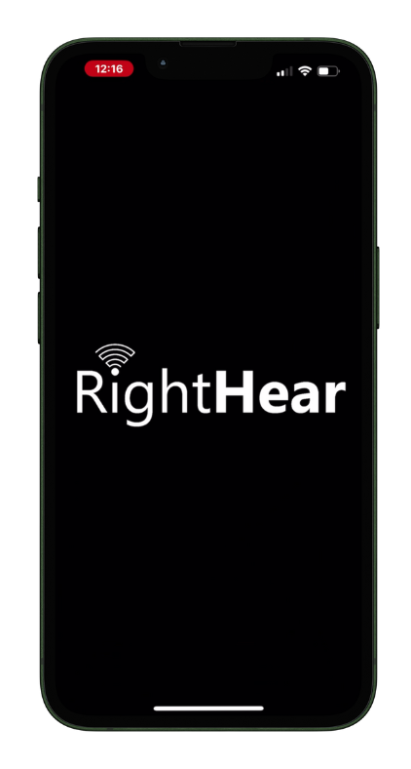
RightHear is a Talking Signage System
The RightHear App allows people who are visually impaired to more easily orientate in public spaces and buildings, and ultimately have more independent and equitable lives.
We work with businesses and organizations, to help them turn their locations into more accessible places.
Our App is 100% free for users, with no signup required.
We support 35 languages, on both iOS and Android.
Confidential
2025 All Rights Reserved

Slide 9
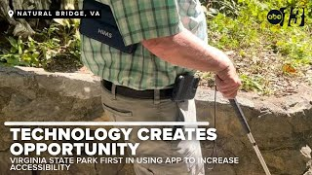
Confidential
2025 All Rights Reserved

Slide 10

Key Benefits
Improves accessibility for everyone
Provides orientation and descriptive info
Available in 35 languages
Easily updatable content
Works fully offline (no cell service needed)
2026 All Rights Reserved
Confidential

Slide 11
















Over 2,500 Locations worldwide
2026 All Rights Reserved
Confidential

Slide 12
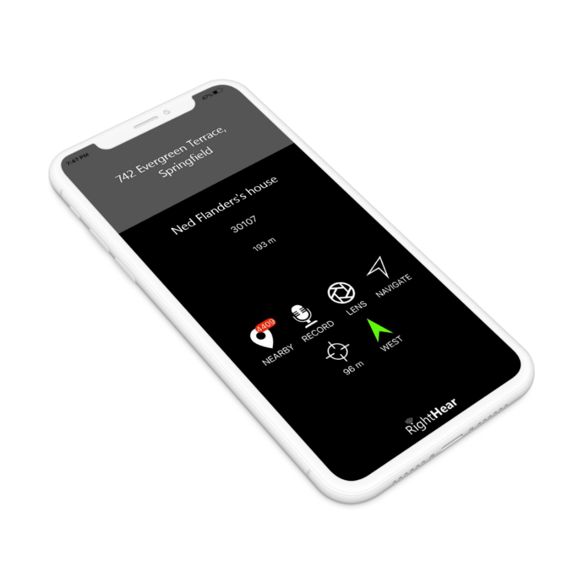

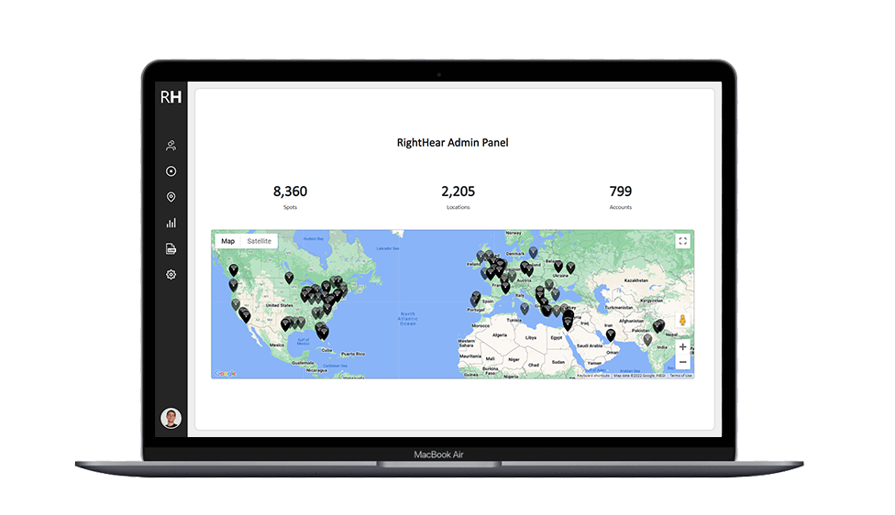
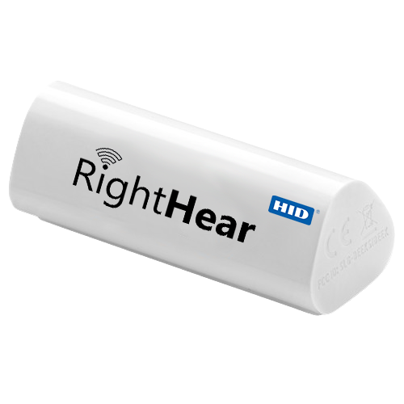
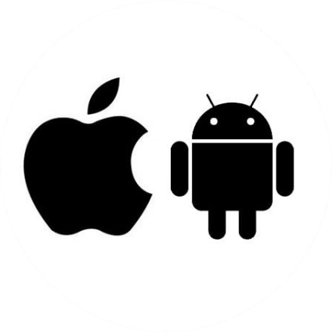



So How Does RightHear Work?
Solution Architecture
Free Mobile App
Beacon / Marker
Admin Dashboard
Confidential
2025 All Rights Reserved
Notes:
Idan Talking

Slide 13
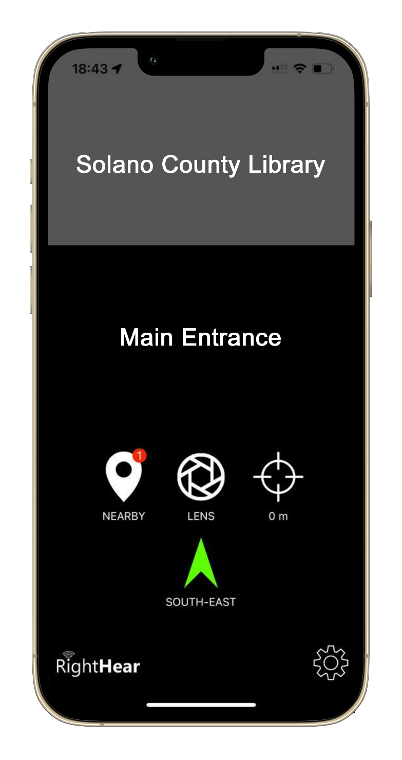
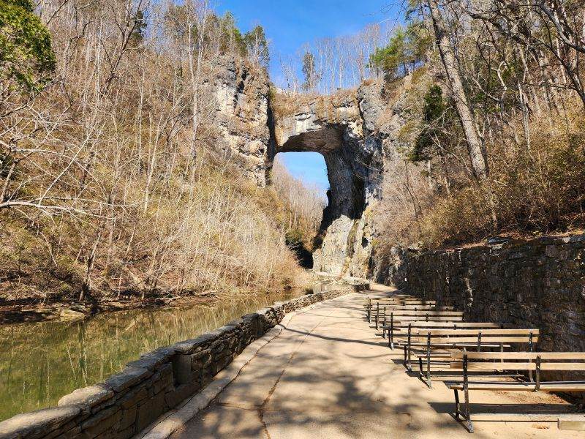
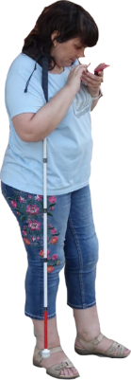
For Wayfinding
Natural Bridge Trail
You are now 0.3 miles along the trail, continue in this direction for another 300 feet to reach the Arch.
Confidential
2025 All Rights Reserved

Slide 14
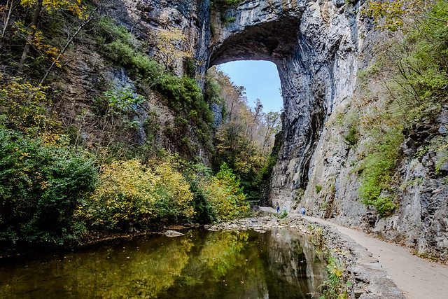
For Descriptive Information
The Natural Bridge
At over 215-foot Natural Bridge is a limestone arch carved by Cedar Creek, a true natural and historic geological wonder.
Confidential
2025 All Rights Reserved

Slide 15
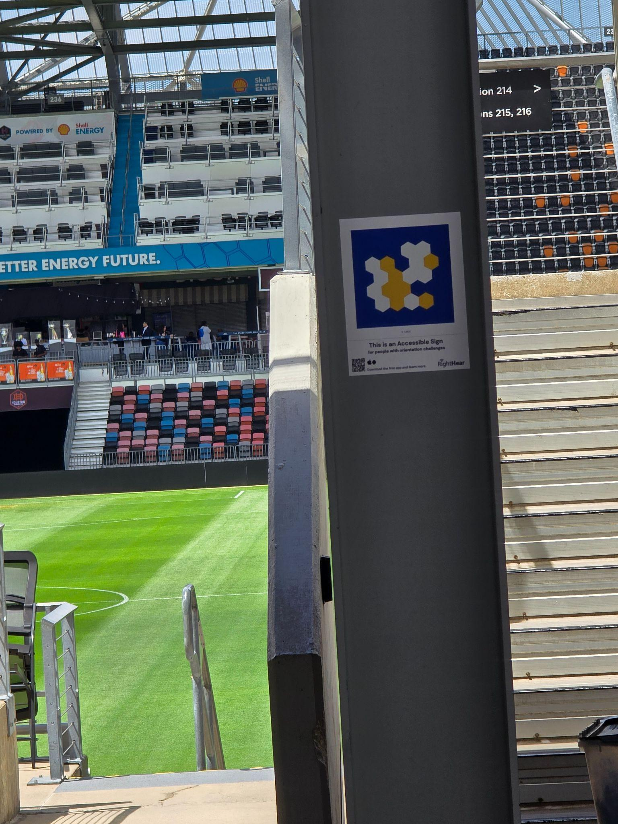
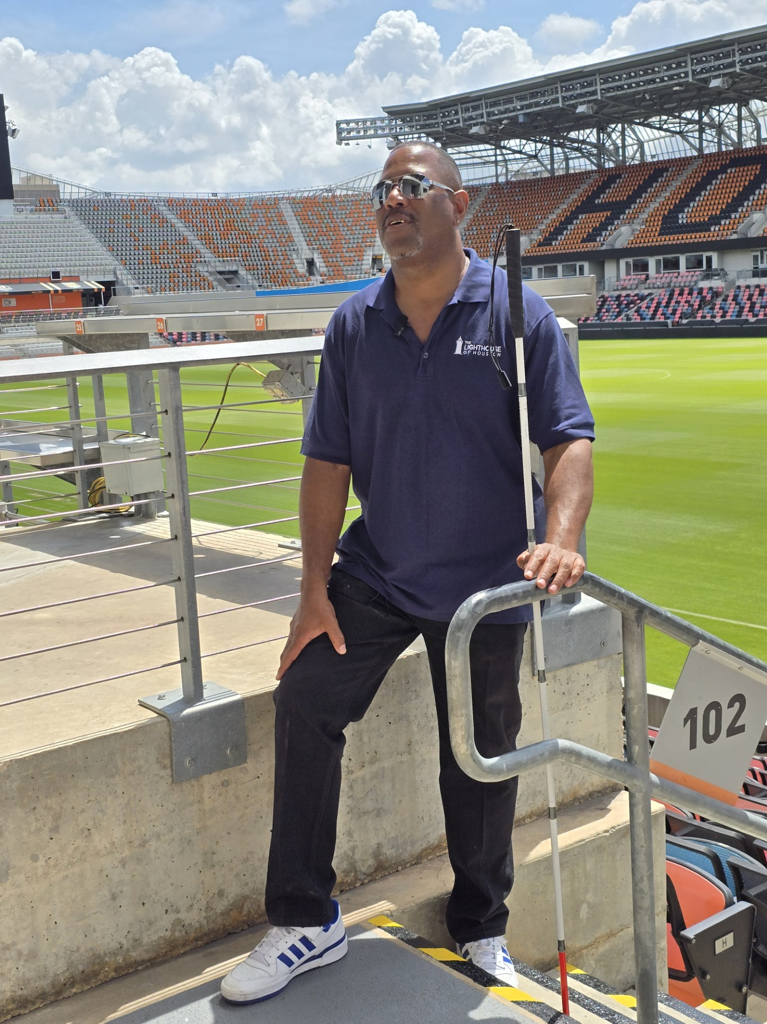
For Wayfinding
Section 102
You are now at Seating Area 102, with Rows A to Z, Seats 1 to 29. Please take care of the stairs leading down, there is a handrail for your assistance.
Confidential
2025 All Rights Reserved

Slide 16
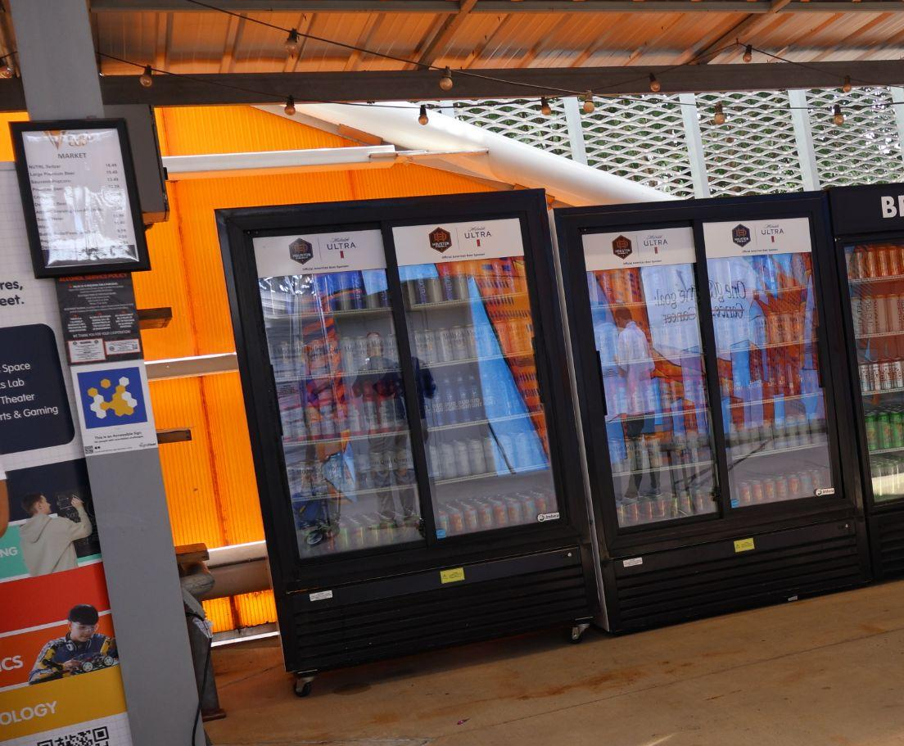
For Descriptive Information
Beverages
To your right you will find a selection of drinks chillers containing Michelob Ultra, Coca Cola and Water.
Confidential
2025 All Rights Reserved

Slide 17
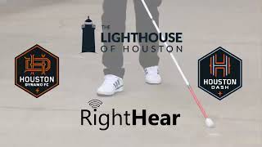
Confidential
2025 All Rights Reserved

Slide 18

What If We All Did It Together?
It’s 2026, and technological advances mean that standard accessibility options are not sufficient, and can be greatly enhanced.
We need a community approach to achieving accessibility in all aspects of life.
Demand change.
Demand independence.
Demand equality.
A right, not a privilege.

Slide 19
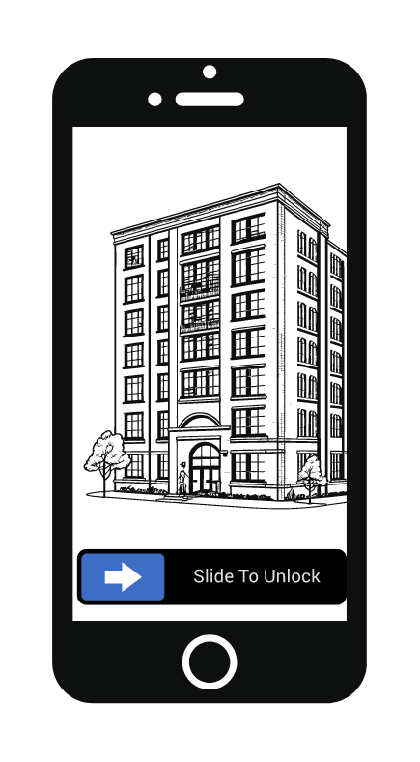
Introducing The Unlock Program

Slide 20

Unlocking New Locations
We want to make more places accessible to all.
But companies and organizations need to be aware of the problem before they can take action.
We need everyone’s help to create this awareness.

Slide 21
An Army of Unlockers!
We are creating a Movement.
An army of Unlockers.
Creating awareness of the importance of accessibility.
Reaching out to places near you and asking them to be more accessible.
Email, phone, in-person - you can make a difference!

Slide 22
Join the Movement
https://docs.google.com/forms/d/e/1FAIpQLSc_tMDDKqMxEHAvNFiCEPmgXdwrdbVauyZwj4QieRJXYxct8A/viewform

Slide 23
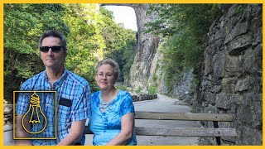
Confidential
2025 All Rights Reserved

Slide 24
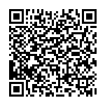
Scan the code to receive more information.
Confidential
2025 All Rights Reserved
Notes:
Idan Talking

Slide 25
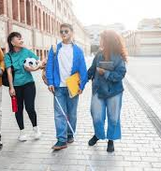
Q&A…
and Thank You!
www.right-hear.com
support@right-hear.com
Confidential
2025 All Rights Reserved

